Slide 1
Snack Squad: A Customizable Snack Ordering And Delivery App

Slide 2
DESCRIPTION:
Snack Squad is a mobile app that lets users customize and order their favorite snacks, delivered straight to their doorstep.
It offers a variety of snack options, personalization features, and fast delivery services to satisfy cravings anytime.
Key Components:
User Interface (UI)
Database & Inventory Management
Order Customization
Payment Gateway
Delivery Module
Recommendation System
Loyalty & Rewards

Slide 3
Program:
import 'package:flutter/material.dart';
void main() {
runApp(MyApp());
}
class MyApp extends StatelessWidget {
@override
Widget build(BuildContext context) {
return MaterialApp(
title: 'Flutter Form Validation',
theme: ThemeData(
primarySwatch: Colors.blue,
),
home: MyFormPage(),
);
}
}
class MyFormPage extends StatefulWidget {
@override
_MyFormPageState createState() => _MyFormPageState();
}

Slide 4
class _MyFormPageState extends State<MyFormPage> {
final _formKey = GlobalKey<FormState>();
final _emailController = TextEditingController();
final _passwordController = TextEditingController();
@override
void dispose() {
_emailController.dispose();
_passwordController.dispose();
super.dispose();
}
String? _validateEmail(String? value) {
if (value == null || value.isEmpty) {
return 'Please enter your email';
}
final emailRegex = RegExp(r'^[\w-]+@([\w-]+\.)+[\w-]{2,4}$');
if (!emailRegex.hasMatch(value)) {
return 'Please enter a valid email';
}
return null;
}
String? _validatePassword(String? value) {
if (value == null || value.isEmpty) {
return 'Please enter your password';
}

Slide 5
if (value.length < 6) {
return 'Password must be at least 6 characters';
}
return null;
}
void _submitForm() {
if (_formKey.currentState?.validate() ?? false) {
// If all validations pass, you can process the data here
ScaffoldMessenger.of(context).showSnackBar(
SnackBar(content: Text('Form submitted successfully!')),
);
}
}
@override
Widget build(BuildContext context) {
return Scaffold(
appBar: AppBar(
title: Text('Flutter Form Validation'),
),
body: Padding(
padding: const EdgeInsets.all(16.0),
child: Form(
key: _formKey,
child: Column(

Slide 6
children: <Widget>[
TextFormField(
controller: _emailController,
decoration: InputDecoration(labelText: 'Email'),
keyboardType: TextInputType.emailAddress,
validator: _validateEmail,
),
TextFormField(
controller: _passwordController,
decoration: InputDecoration(labelText: 'Password'),
obscureText: true,
validator: _validatePassword,
),
SizedBox(height: 20),
ElevatedButton(
onPressed: _submitForm,
child: Text('Submit'),
),
],
),
),
),
);
}
}

Slide 7
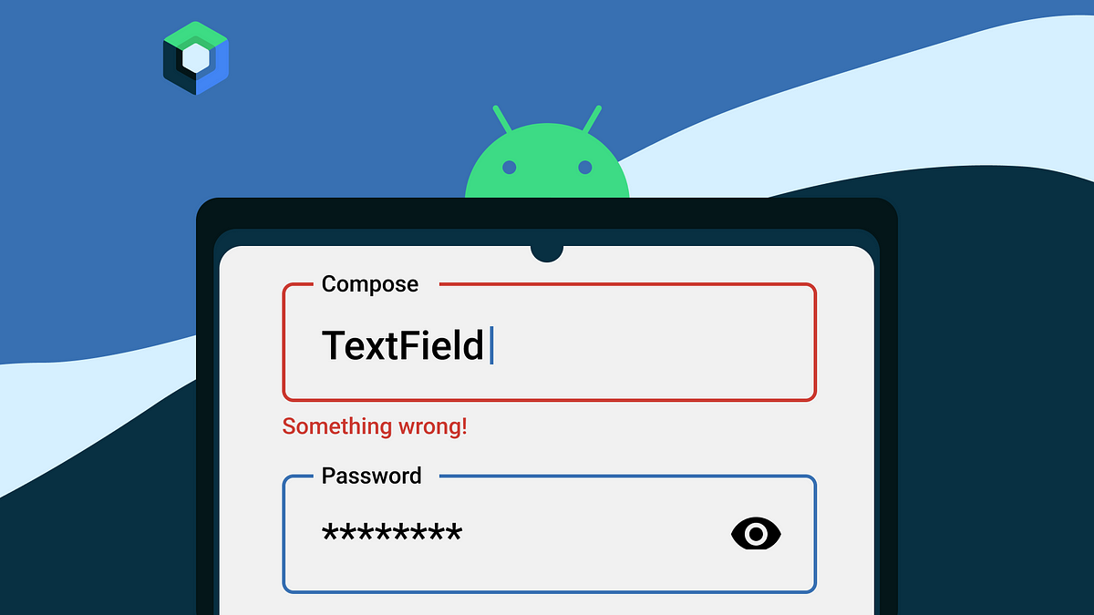
Features:
Email and Password Input Fields: The program has TextFormField widgets for email and password, with each field set up for specific input types (TextInputType.emailAddress and obscureText for password).
Real-Time Validation: The _validateEmail and _validatePassword functions provide validation on each field, displaying an error message if input does not meet criteria.
Error Messaging: Error messages are shown inline if validation fails, using validator callbacks within the TextForm Field widgets.
Form Submission Feedback: When the form is successfully validated, a SnackBar shows a success message (handled by _submitForm function).

Slide 8
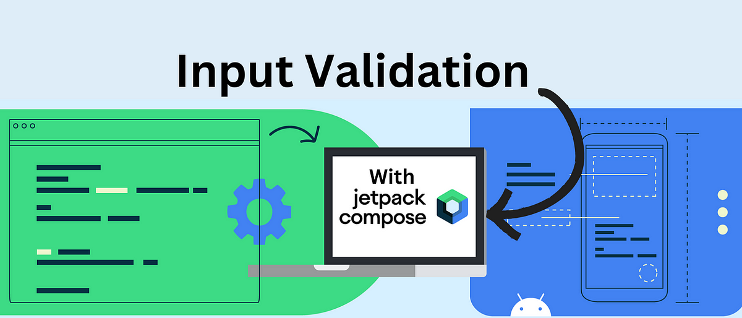
Architecture and Design:
Single Page Structure: The MyFormPage class is the main page where form input and validation are handled.
State Management: The use of StatefulWidget in _MyFormPageState allows the app to manage and update the form’s state dynamically.
Controllers and GlobalKey: Separate controllers for email and password (_emailController, _passwordController) allow for input management, and _formKey handles the form state, enabling validation.
Validation Logic: Email validation uses a regex to ensure proper format, and password validation checks for minimum character length.

Slide 9
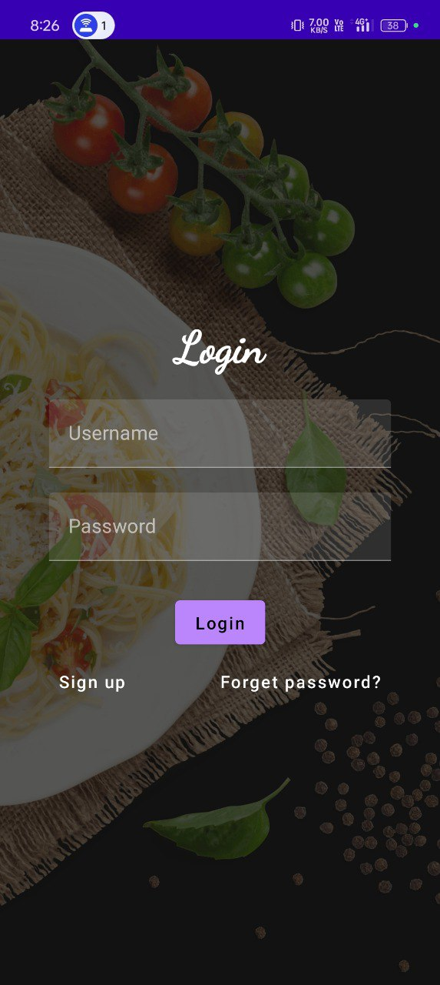
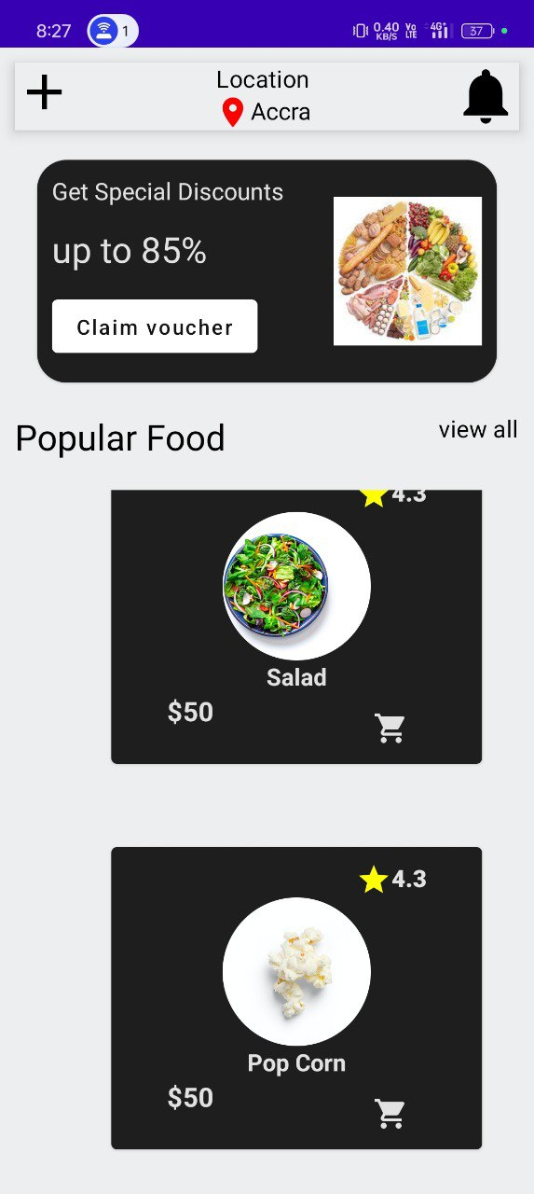
OUTPUT:

